Slide 1


Using Social Media To Enhance Emergency Situation Awareness
Engineering in Computer Science
Visual analytics, ay 2020/2021
04/05/2021

Slide 2
The Team
David Guzman -> 1909580
Hamza Bouzidi -> 1909250

Slide 3
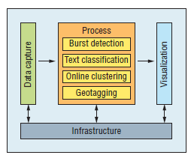
Motivations
Reference paper:
J. Yin, A. Lampert, M. Cameron, B. Robinson and R. Power, "Using Social Media to Enhance Emergency Situation Awareness," in IEEE Intelligent Systems, vol. 27, no. 6, pp. 52-59, Nov.-Dec. 2012, doi: 10.1109/MIS.2012.6.
Motivation and goals:
> SITUATION AWARENESS
(perception + comprehension + projection)
NLP, ML, Data Mining
tweets during crisis
ubiquity
communication rapidity
cross-platform accessibility
real-time nature
knowledge for emergency response
emergency management
crisis coordination
decision making
Notes:
SITUATION AWARENESS is defined as : (i) perception, (ii) comprehension, (iii) projection
gathering info about outbreak of disaster => burst detection
about affected area => geotagging
understand type of disaster, impact, damage => tweet filtering, clustering
Use NLP, Data Mining, ML techniques to extract situation awareness information from tweets generated during disasters and crises, to improve emergency management, crisis coordination and decision making. The key points to attack is the detection, classification and grouping of tweets related to disasters.

Slide 4
Online Clustering: Description
Dataset and ground truth:
.csv extracted from CrisisNLP
human-labeled tweets
3000 tweets related to natural disasters
Earthquake, Hurricane, Volcano, MERS, Typhon, Cyclone, Airplane disaster
Assumptions and simplifications:
No time distance between tweets.
No prefiltering of unimportant tweets (No usage of burst-detection)
About the model:
Text preprocessing (tokenization, stop words, remove of frequent words, etc)
Tf-idf representation of the tweets using tf-idf vectorizer
Online incremental clustering
Similarity measures: cosine and jaccard coefficient
Evaluation metrics:
Clustering quality through comparison with offline clustering
We know in advance the number of labels on dataset
Clustering quality using the Silhouette score

Slide 5
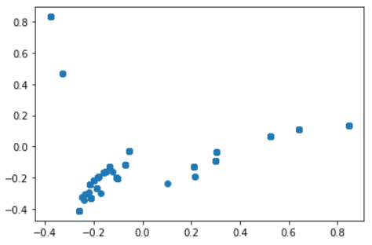
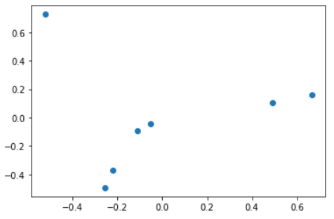
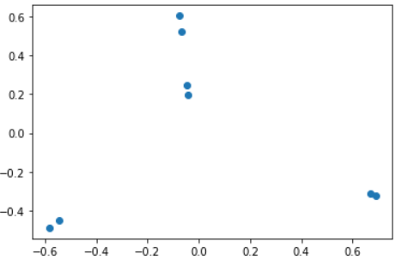
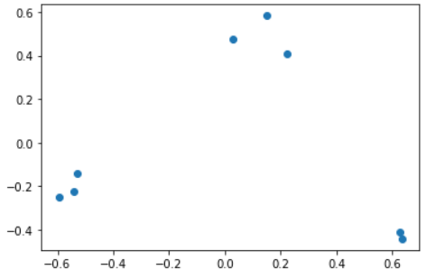
Online Clustering: results
Tweets
K-means
Silhouette score = 0.75
Cosine
Silhouette score = 0.59
Jaccard
Silhouette score = 0.64

Slide 6
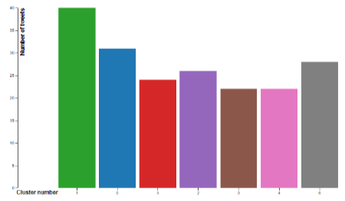
Visualizations: bar plot
Clear way to reveal tendencies
Identify clusters with most of relevant information

Slide 7
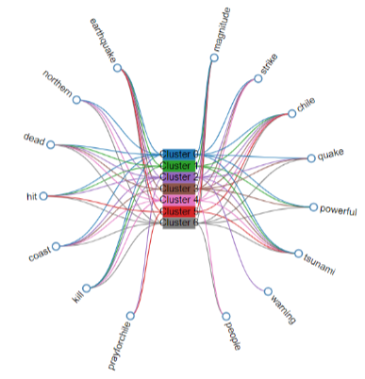
Visualizations: concept map
Get the most important concepts at each cluster
Bidirectional flow of information (concepts <->cluster)

Slide 8
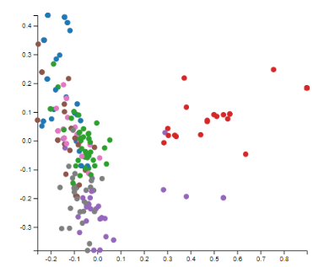
Visualizations: 2D scatter plot
Comparision on behaviour between the two clusters
PCA projection on a 2D space

Slide 9
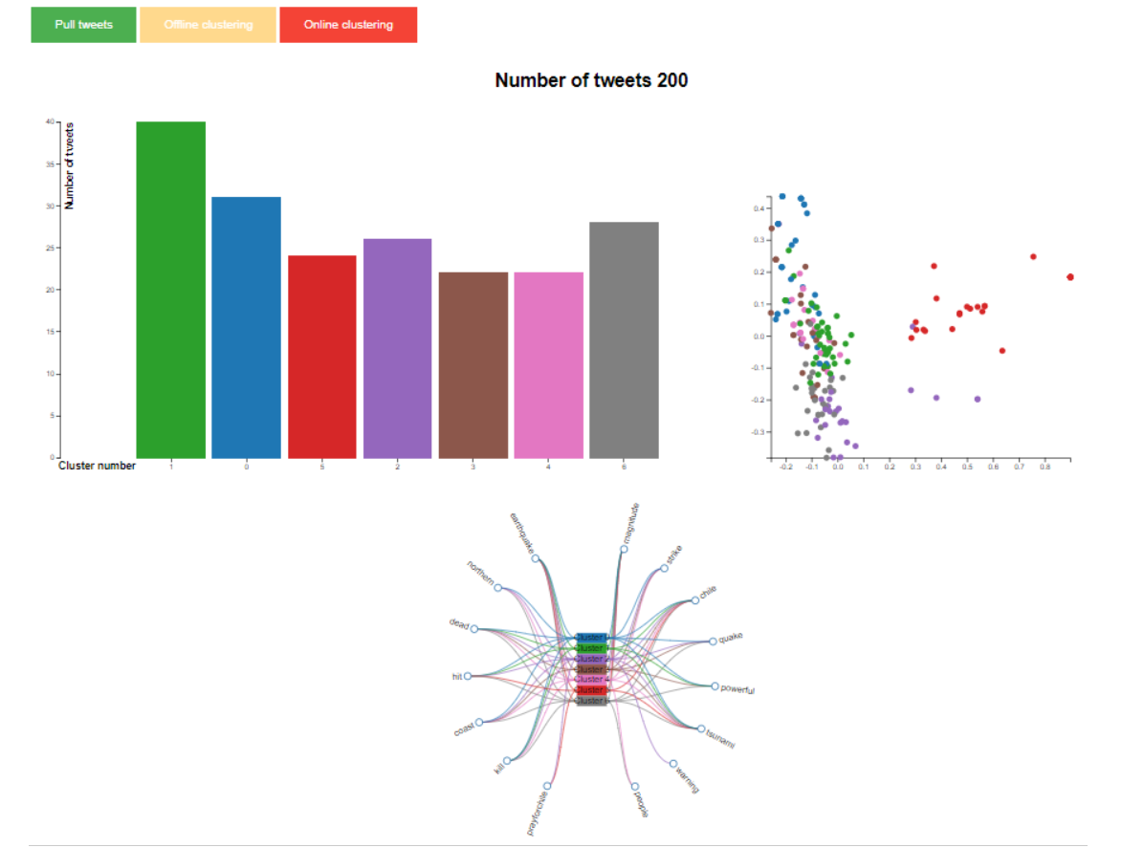
Visualizations: final interface

Slide 10
Conclusions
The TF-IDF representation must be used and tuned carefully in order to not remove relevant information.
Quality of clusters is a key aspect when evaluating the efficiency of clustering algorithm and also a research field.
We found concept map as one of the key on the information visualization
PCA was a good tool for a comparison between the two algorithms used in this work.

Slide 11
Future works and improvements
Consider the semantic of hashtags: split hashtags considering as features both the hashtag as it is, and splitted
(ex: #PrayForChile generates the features ‘prayforchile’, ‘pray’, ‘for’, ‘chile’, you’ll increase the vocabulary size, but you’ll get more information)
Consider also photos posted with the tweets for visualization and related
Include time distance for clustering tweets and visualization
Combine burst detection with clustering algorithm for event detection and grouping

Slide 12
Thanks
for your
attention!

